Slide 1



BAR APPLICATION
Master Degree in
ICT for Internet and Multimedia​
- Homework​ 2 -
Client-side/overall design and
implementation
Group BAR
8th June 2026​
1

Slide 2
Index
Bar Application
Our team
Frontend
1
4
Main features
Demo
2
5
Backend
Member contribution
3
6
2

Slide 3

1
OUR TEAM
3

Slide 4



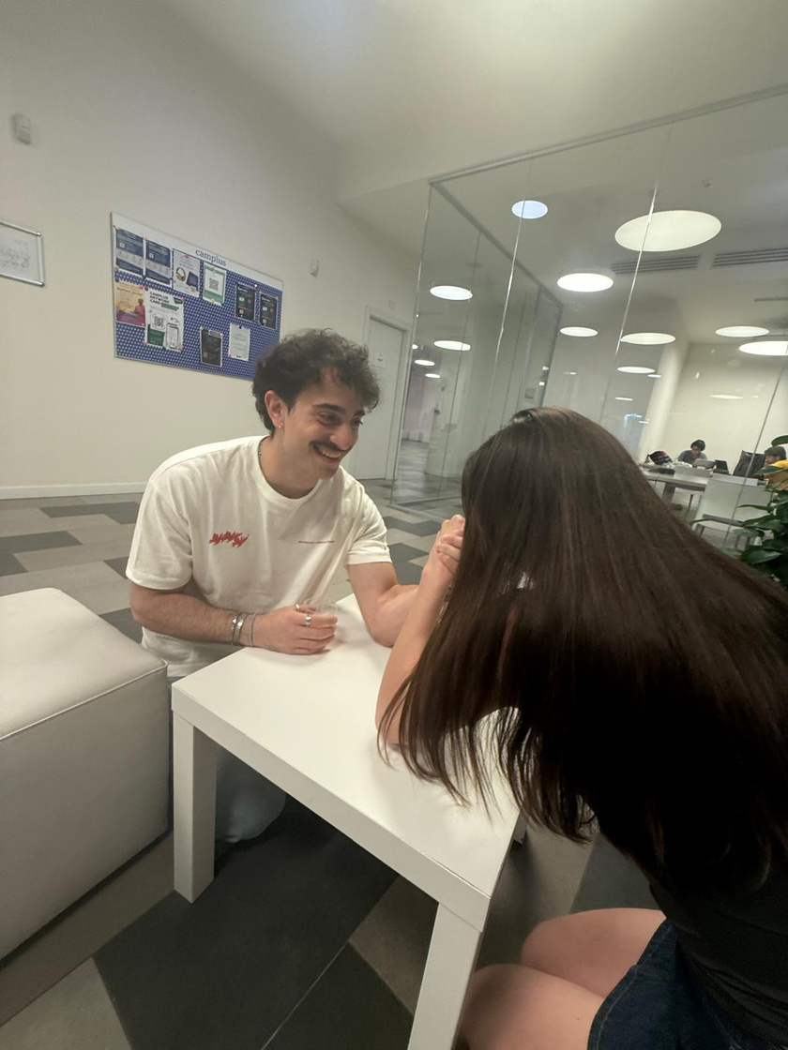
Our Team
Bar Application
Foffano
Claudia
Iacobet
Ecaterina
Nuñez
Luis
Bruzzese
Fulvio
4
Notes:
This slides shows all of us connected, splitting all our work

Slide 5

MAIN FEATURES
2
5

Slide 6
The problem
Bar Application
Sounds familiar?
6
Notes:
Explain that we have two roles and we will show the features (actions) of each role

Slide 7
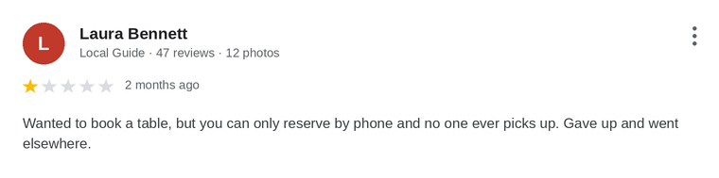
The problem
Bar Application
Sounds familiar?
7
Notes:
Explain that we have two roles and we will show the features (actions) of each role

Slide 8
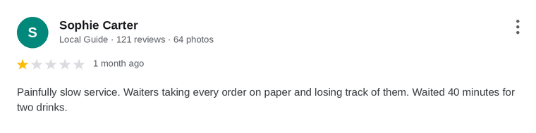
The problem
Bar Application
Sounds familiar?
8
Notes:
Explain that we have two roles and we will show the features (actions) of each role

Slide 9
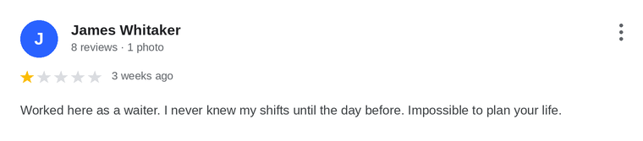
The problem
Bar Application
Sounds familiar?
9
Notes:
Say that even a waiter complaining

Slide 10

The solution
Bar Application
Book Reservations
WE TURNED EVERY COMPLAINT INTO A FEATURE
Make orders
Manage shifts
10
Notes:
Explain that we have two roles and we will show the features (actions) of each role

Slide 11

Login Service
Bar Application
Role-Based Application
Waiter
Customer
11
Notes:
Explain that we have two roles and we will show the features (actions) of each role

Slide 12
Main Features
Bar Application
rOLE SEPARATION
book reservations
Role-based access keeps every user to the right features
Reserve your table in advance and skip the wait.
leave reviews
MAKE ORDERS
Share your feedback about your experience at LoungeBar.
Start an order and pick the drinks for your table.
manage shifts
manage supplies
A simple interface to organize waiter shifts.
Track stock in real time and never run out.
12
Notes:
As we already said, the login service allows for the role separation.
Remove some text??

Slide 13

3
BACKEND
13

Slide 14





Tools
Bar Application
14
Notes:
The backend was developed using the following tools:
explain the role of each tools?
Maven for project build and dependency management;
Docker for containerization;
IntelliJ IDEA - the development environment;
Git for version control;
PostgreSQL as the relational database;
Apache Tomcat as the web application server

Slide 15
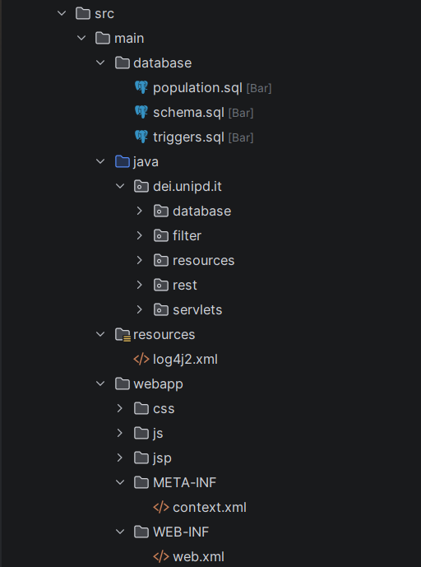
PROJECT STRUCTURE
15
Notes:
briefly, just that the project follows a standard maven web app

Slide 16
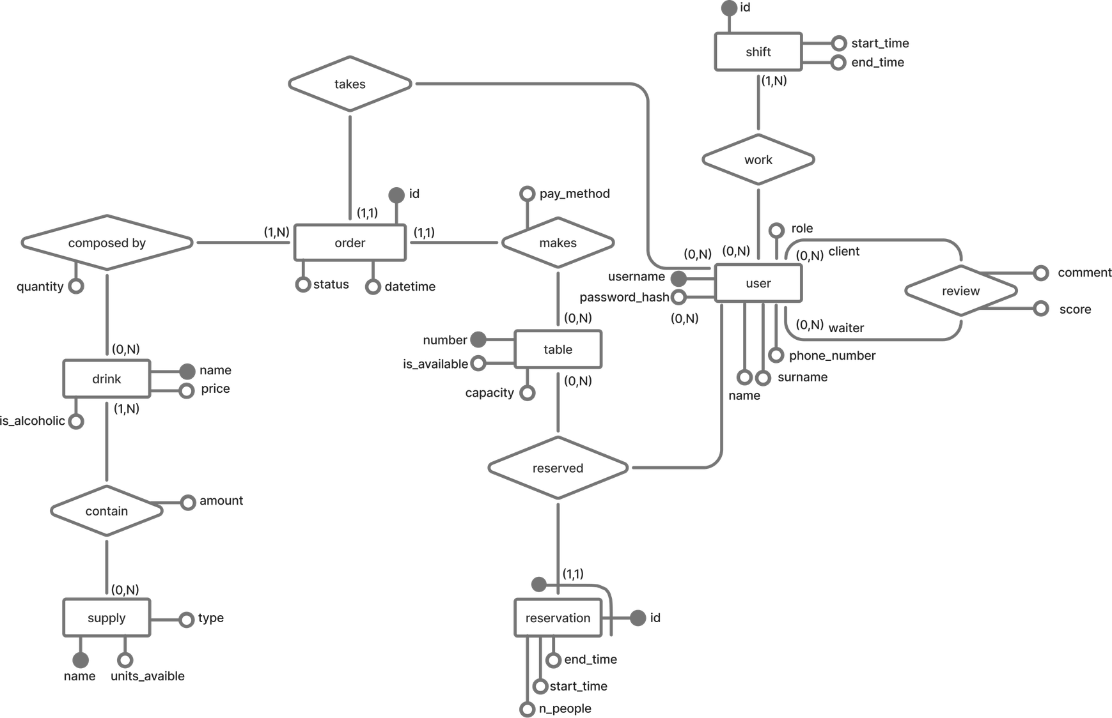
Data layer - ER Schema
Bar Application
16

Slide 17
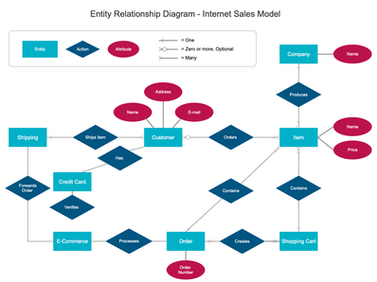
Data layer files
Bar Application
schema.sql
population.sql
triggers.sql
17
Notes:
VERY BRIEF, don't go a lot on database.
Our 3 .qsl files and what each does.
Schema - basic ER schema
Population - Putting objects into the schema
Trigger for exceptions

Slide 18
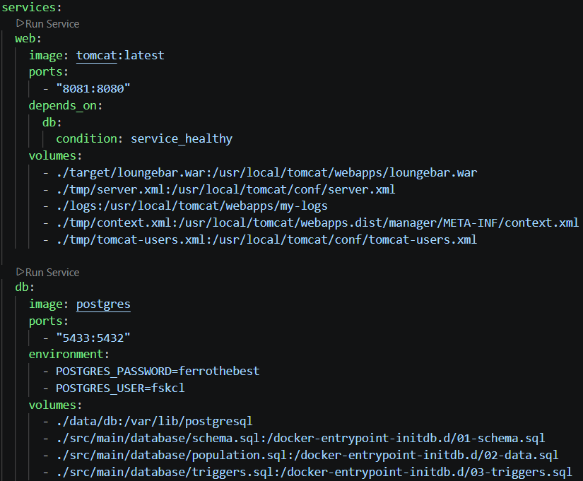


Containerization
Bar Application
Service: WEB
Container
Service: db
Container
18
Notes:
SERVICES

Slide 19


Containerization
Bar Application
Service: WEB
Container
Service: db
Container
19

Slide 20
Containerization
Bar Application
WAR File
Database
20
Notes:
VOLUMES

Slide 21
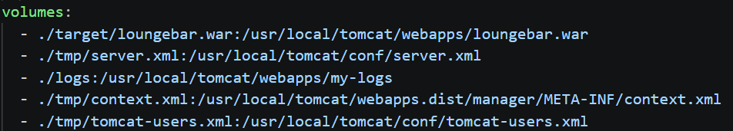
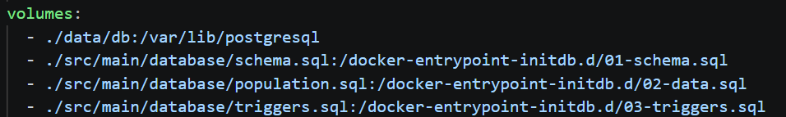
Containerization
Bar Application
WAR File
Database
21
Notes:
REMEMBER TO SAY .WAR file because of webapp

Slide 22
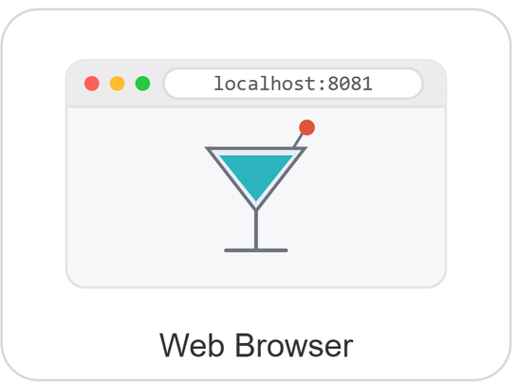
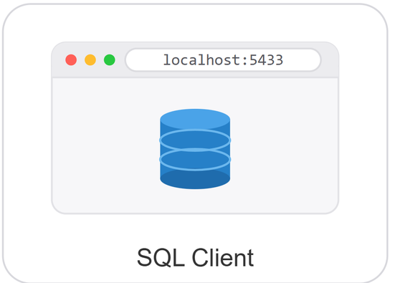
Containerization
Bar Application
22
Notes:
NETWORK AND PORTS

Slide 23


Containerization
Bar Application
23

Slide 24
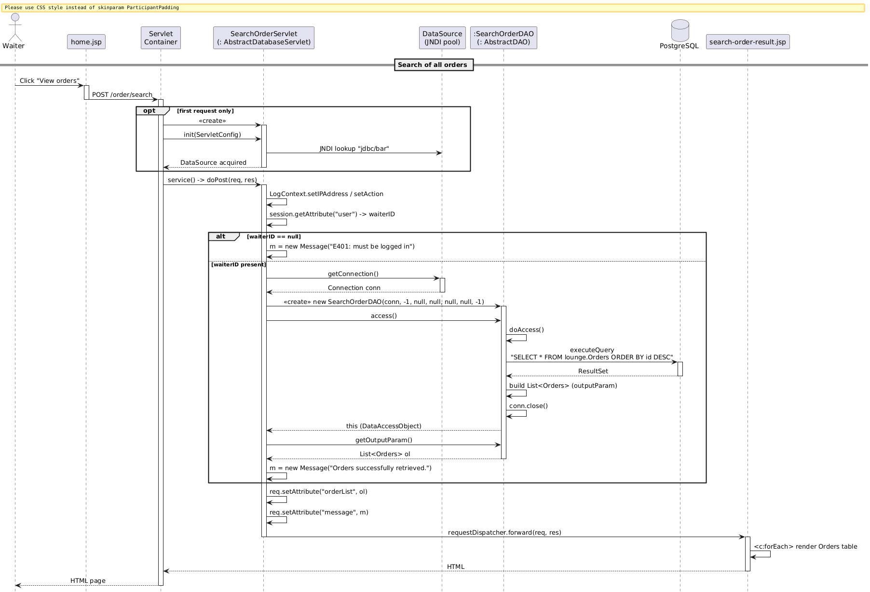
Servlets: Sequence Diagram
Bar Application
24
Notes:
Expanation of the diagram with jsp and servlets

Slide 25
Servlets: Sequence Diagram
Bar Application
25
Notes:
Expanation of the diagram with jsp and servlets

Slide 26
Servlets: Sequence Diagram
Bar Application
26
Notes:
Expanation of the diagram with jsp and servlets

Slide 27
Servlets: Sequence Diagram
Bar Application
27
Notes:
Expanation of the diagram with jsp and servlets

Slide 28
Servlets: Sequence Diagram
Bar Application
28
Notes:
Expanation of the diagram with jsp and servlets

Slide 29
Servlets: implementation
Bar Application
29
Notes:
Expanation of the diagram with jsp and servlets

Slide 30
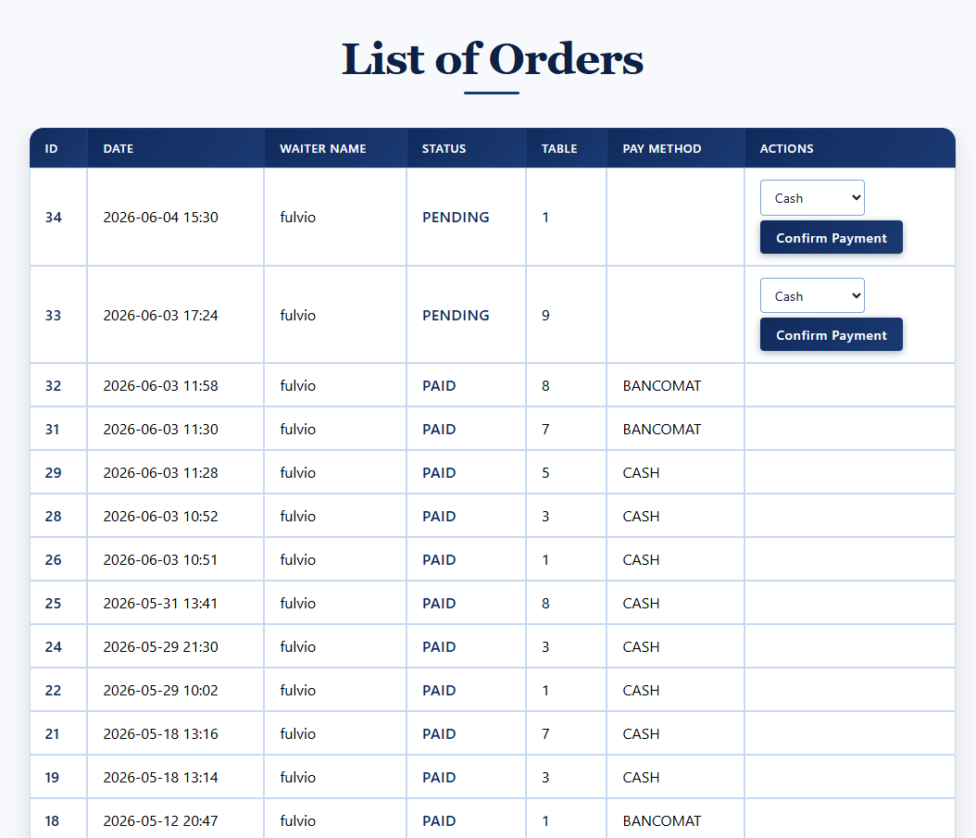
Servlets: implementation
Bar Application
30
Notes:
Expanation of the diagram with jsp and servlets

Slide 31
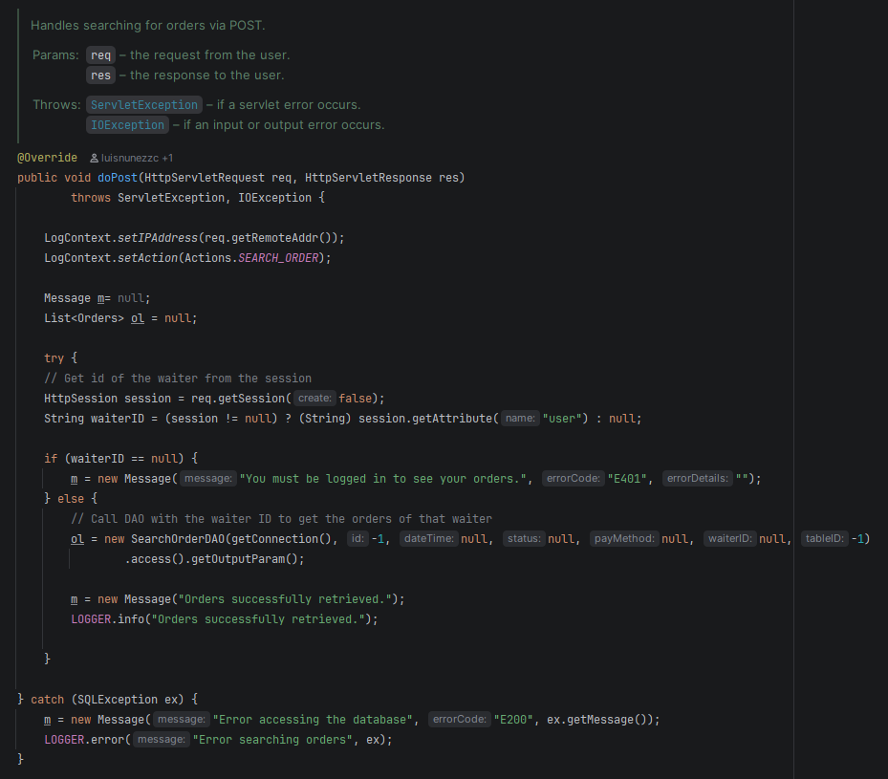
Servlets: implementation
Bar Application
31
Notes:
Expanation of the diagram with jsp and servlets

Slide 32
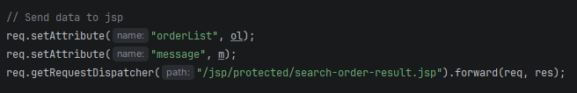
Servlets: implementation
Bar Application
32
Notes:
Expanation of the diagram with jsp and servlets

Slide 33
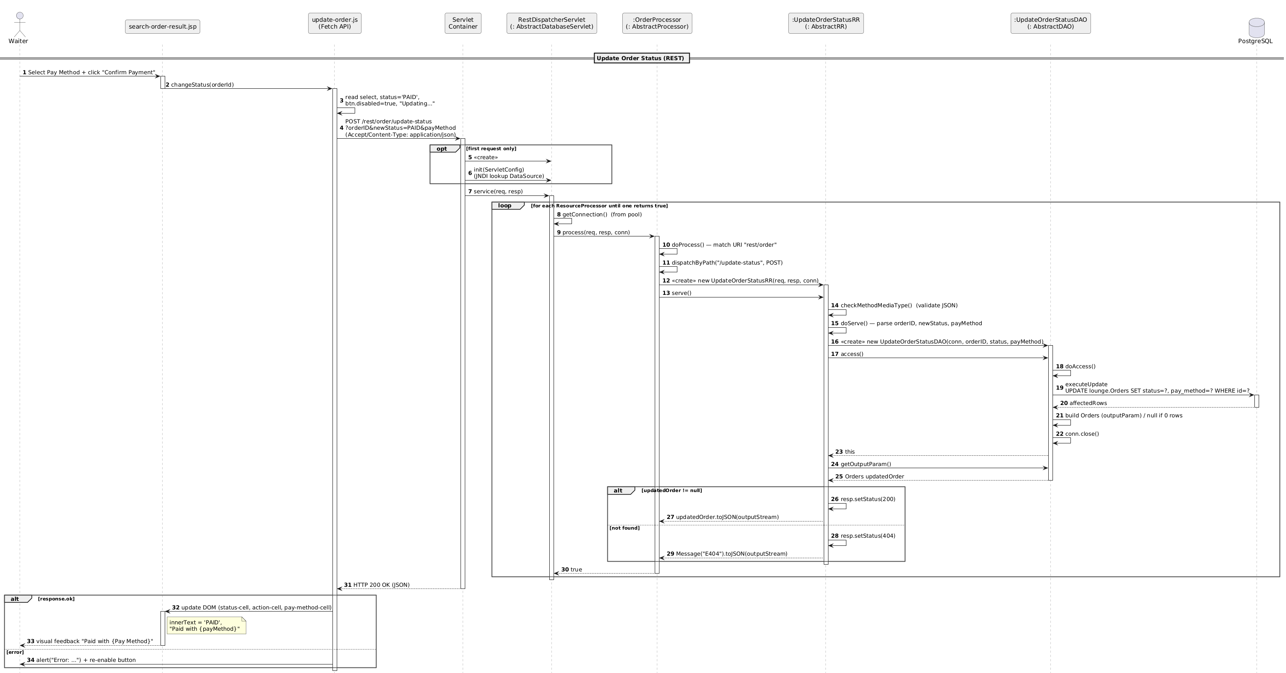
REST: Sequence Diagram
Bar Application
33
Notes:
In this we explain the REST sequence diagram (the change from before slide is important)

Slide 34
REST: Sequence Diagram
Bar Application
34
Notes:
Explain that part, not very deep

Slide 35
Sequence Diagram REST
Bar Application
REST: Sequence Diagram
Bar Application
35
Notes:
In this we explain the REST sequence diagram (the change from before slide is important)

Slide 36
REST: Sequence Diagram
Bar Application
36
Notes:
Mention the final change in the view

Slide 37
REST: implementation
Bar Application
37
Notes:
Mention the final change in the view

Slide 38
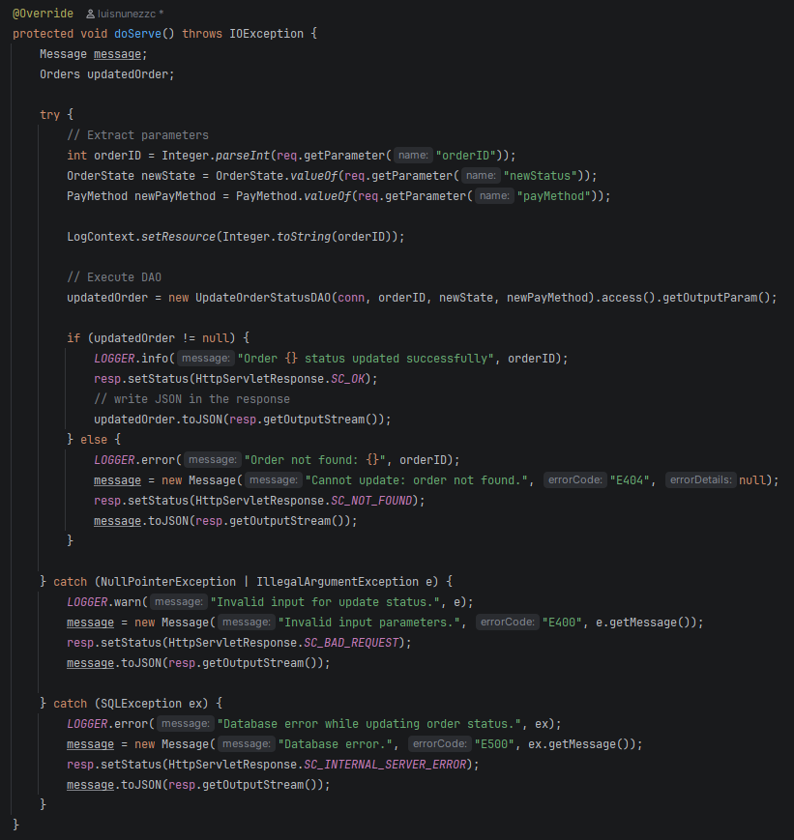
REST: implementation
Bar Application
38
Notes:
Mention the final change in the view

Slide 39
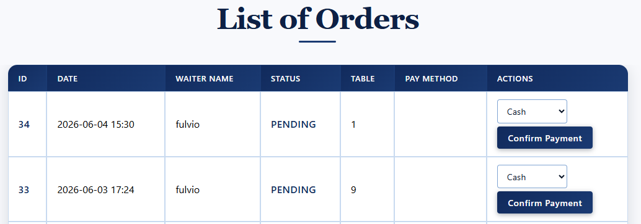
REST: implementation
Bar Application
39
Notes:
Mention the final change in the view

Slide 40
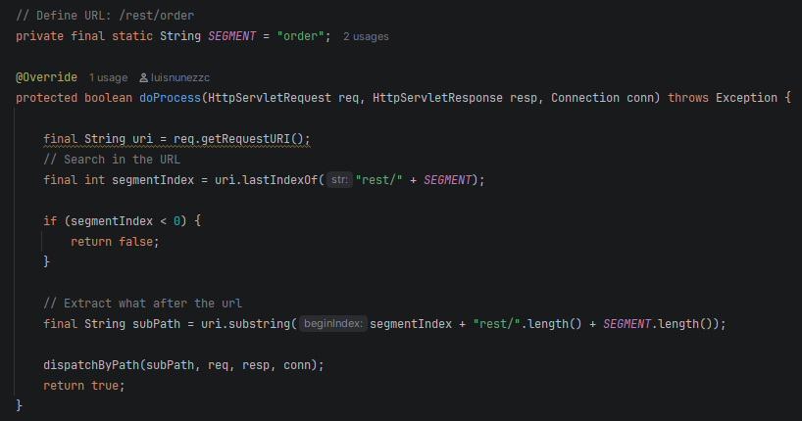
REST: implementation
Bar Application
40
Notes:
Mention the final change in the view

Slide 41
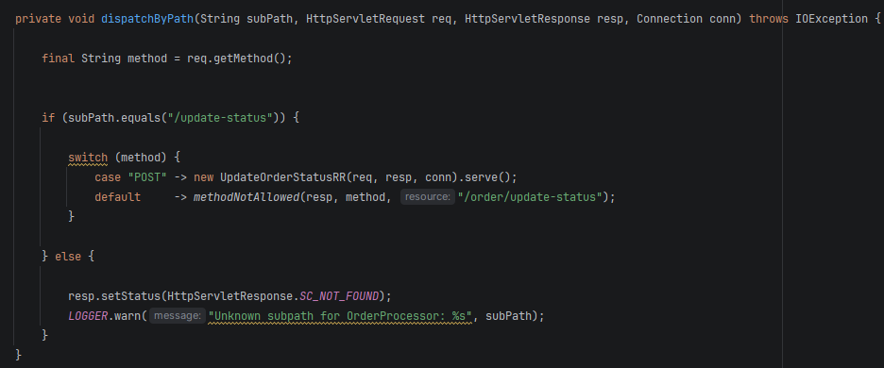
REST: implementation
Bar Application
41
Notes:
Mention the final change in the view

Slide 42
REST: implementation
Bar Application
42
Notes:
Mention the final change in the view

Slide 43
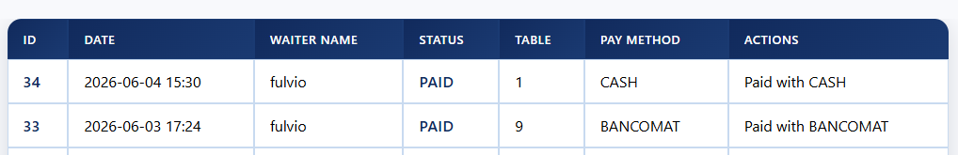
REST: implementation
Bar Application
43
Notes:
Mention the final change in the view

Slide 44

4
FRONTEND
44

Slide 45
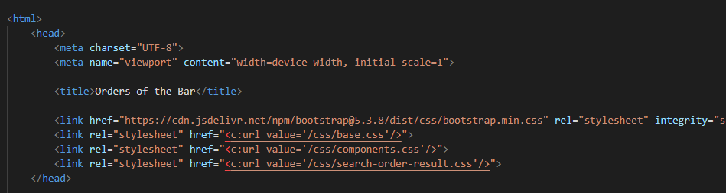
External Style Sheets
Bar Application
JSP file
45
Notes:
Talk about base, components

Slide 46
External Style Sheets
Bar Application
Independency;
Reusability;
Easier maintenance;
Code-separation;
Reduce repetition;
Consistency;
46
Notes:
Talk about base, components

Slide 47
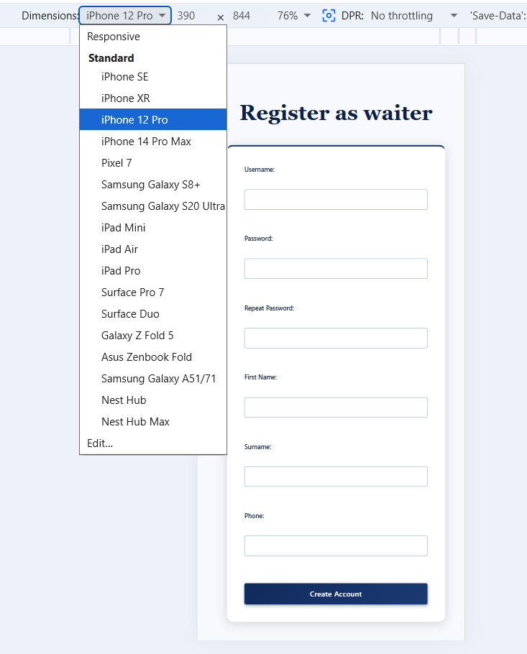
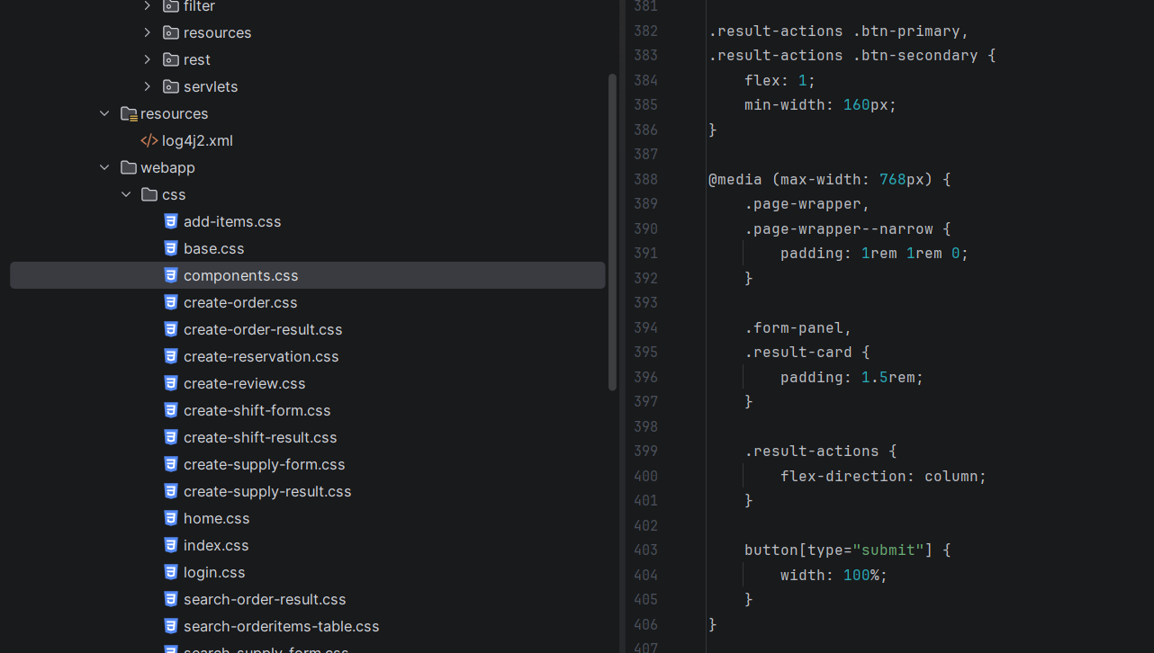
Responsiveness
Bar Application
Media Query
47
Notes:
Mention the Media Query to achiveve the responsiveness. Say that in this example we put te condition of the max-width.
Again say that this will be shown in the Demo

Slide 48
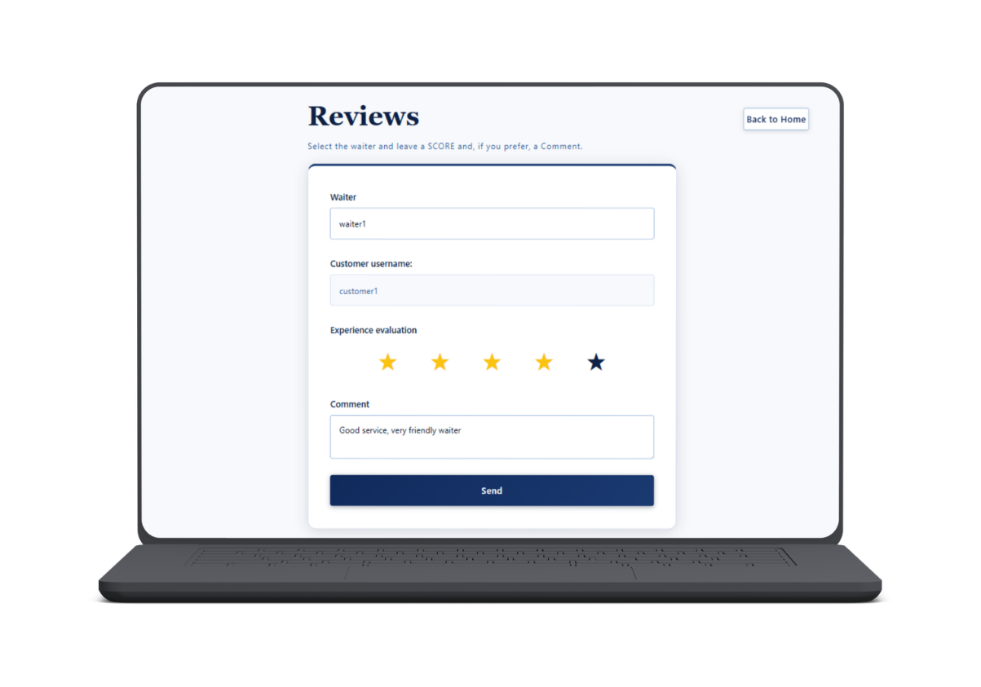
Some examples
Bar Application
48
Notes:
Examples of style of page. Don't go very deep, SAY THAT WE WILL SHOW IT LATER ON THE DEMO

Slide 49
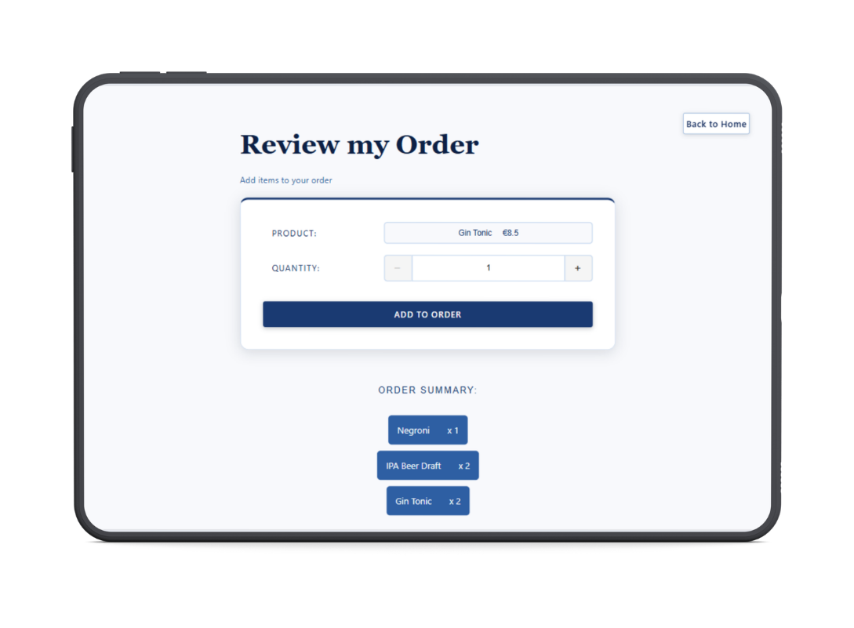
Some examples
Bar Application
49
Notes:
Examples of style of page. Don't go very deep, SAY THAT WE WILL SHOW IT LATER ON THE DEMO

Slide 50
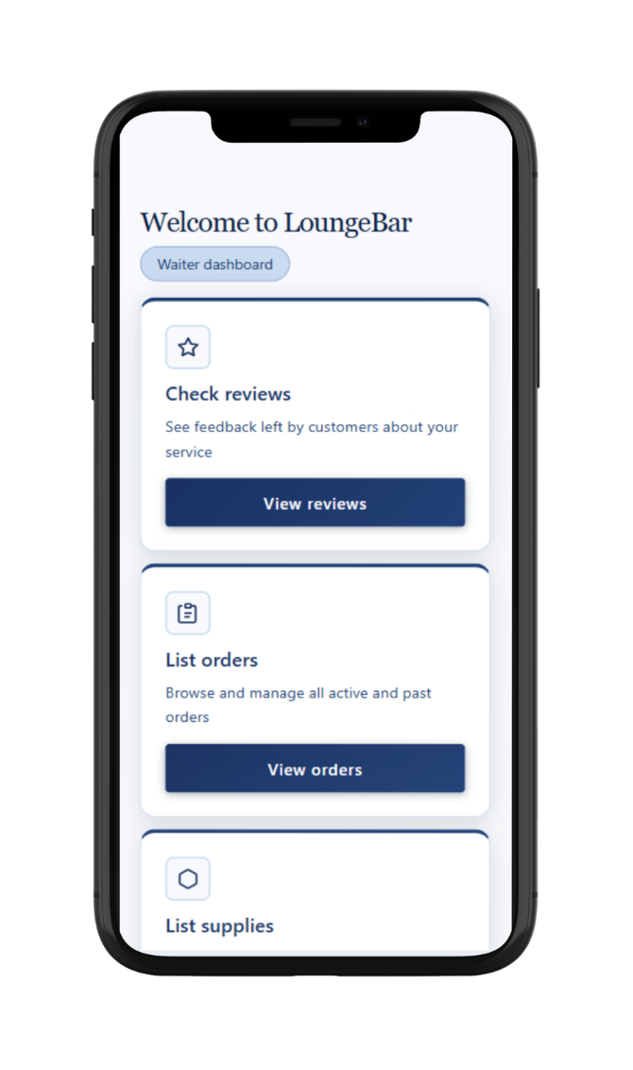
Some examples
Bar Application
50

Slide 51

5
DEMO
51
Notes:
IDEAS to show in the demo:
1) Changing responsiveness !!
2) Show a bad password
or Show trying to sign up as a waiter being a customer
3) List the supplies
4) login as a customer and create a review to show the REST response
5) Go into docker, lounge.Users and show password encoded
6) Show tomcat?

Slide 52
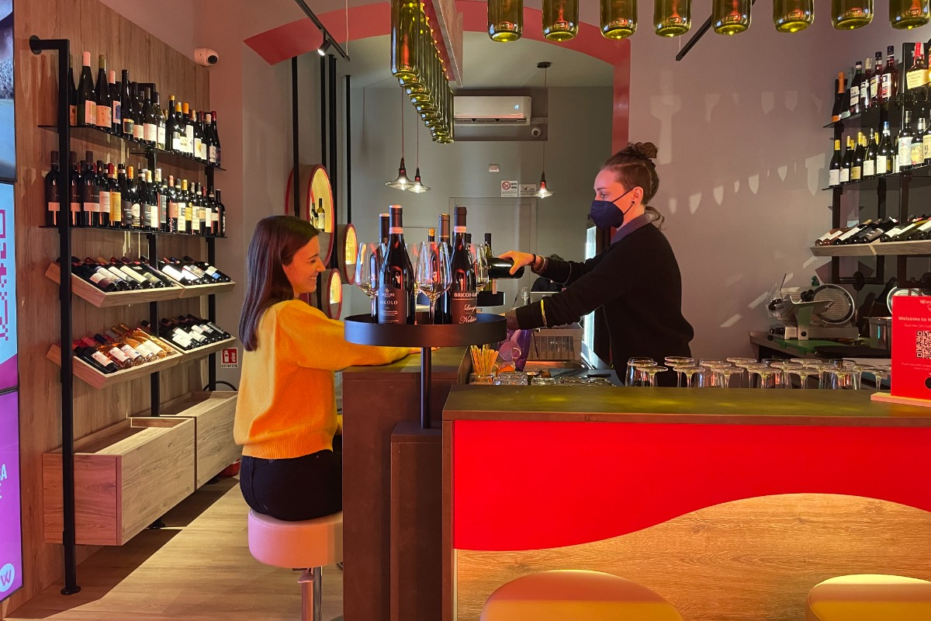
6
MEMBER CONTRIBUTIONS
52

Slide 53
Contribution
Bar Application
Bruzzese
Fulvio
Foffano
Claudia
Iacobet
Ecaterina
Nuñez
Luis
  Reservation Management Service
  Review Management Service
  Supply Management Service
  Order Items Service
  Landing Page
  Login Service
  Sign Up Service
  Create Supply Management Service
  Shift management service
  Home Page representation
  Supply Management service
  common components
  Order Management Service
  Waiter Review Service
  search Order Service
  Waiter Shifts Service
53
Notes:
Here you can see the contribution.
Mainly say that we did almost the same amount of work and everyone did a part on everything (backend, database, frontend)

Slide 54
Thank you for
your attention!
54
Notes:
Examples of style of page. Don't go very deep, SAY THAT WE WILL SHOW IT LATER ON THE DEMO

Slide 55
55

